Slide 1



Weather Forecasting
Using Machine Learning
By,
- A. Koundinya
- M. Ameer Sohail
- M. Lalith Krishna Reddy

Slide 2
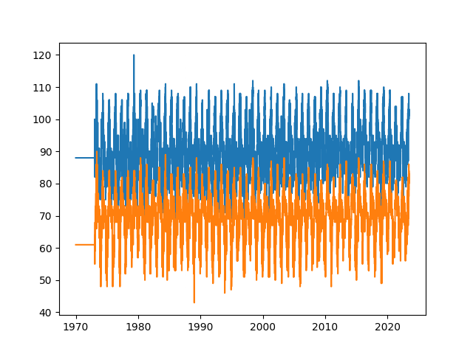
Temp_max vs Temp_min

Slide 3
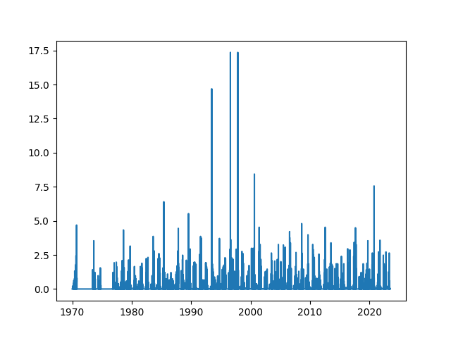
Precipitation over the years

Slide 4
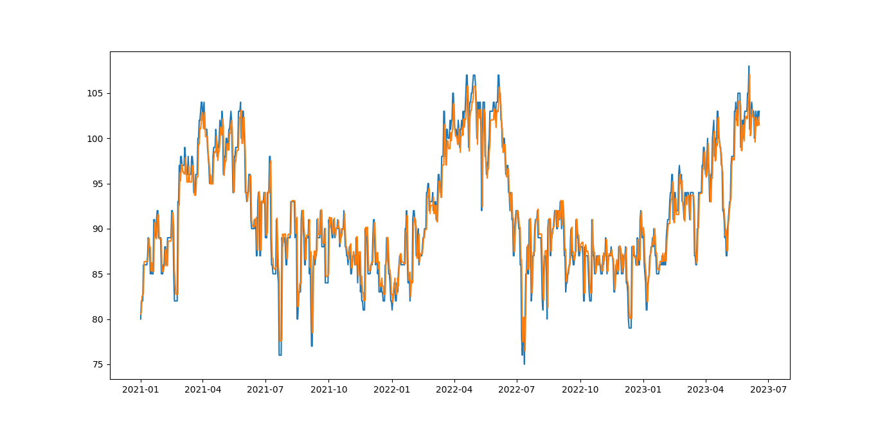
Actual Value vs Predicted Value

